Slide 1
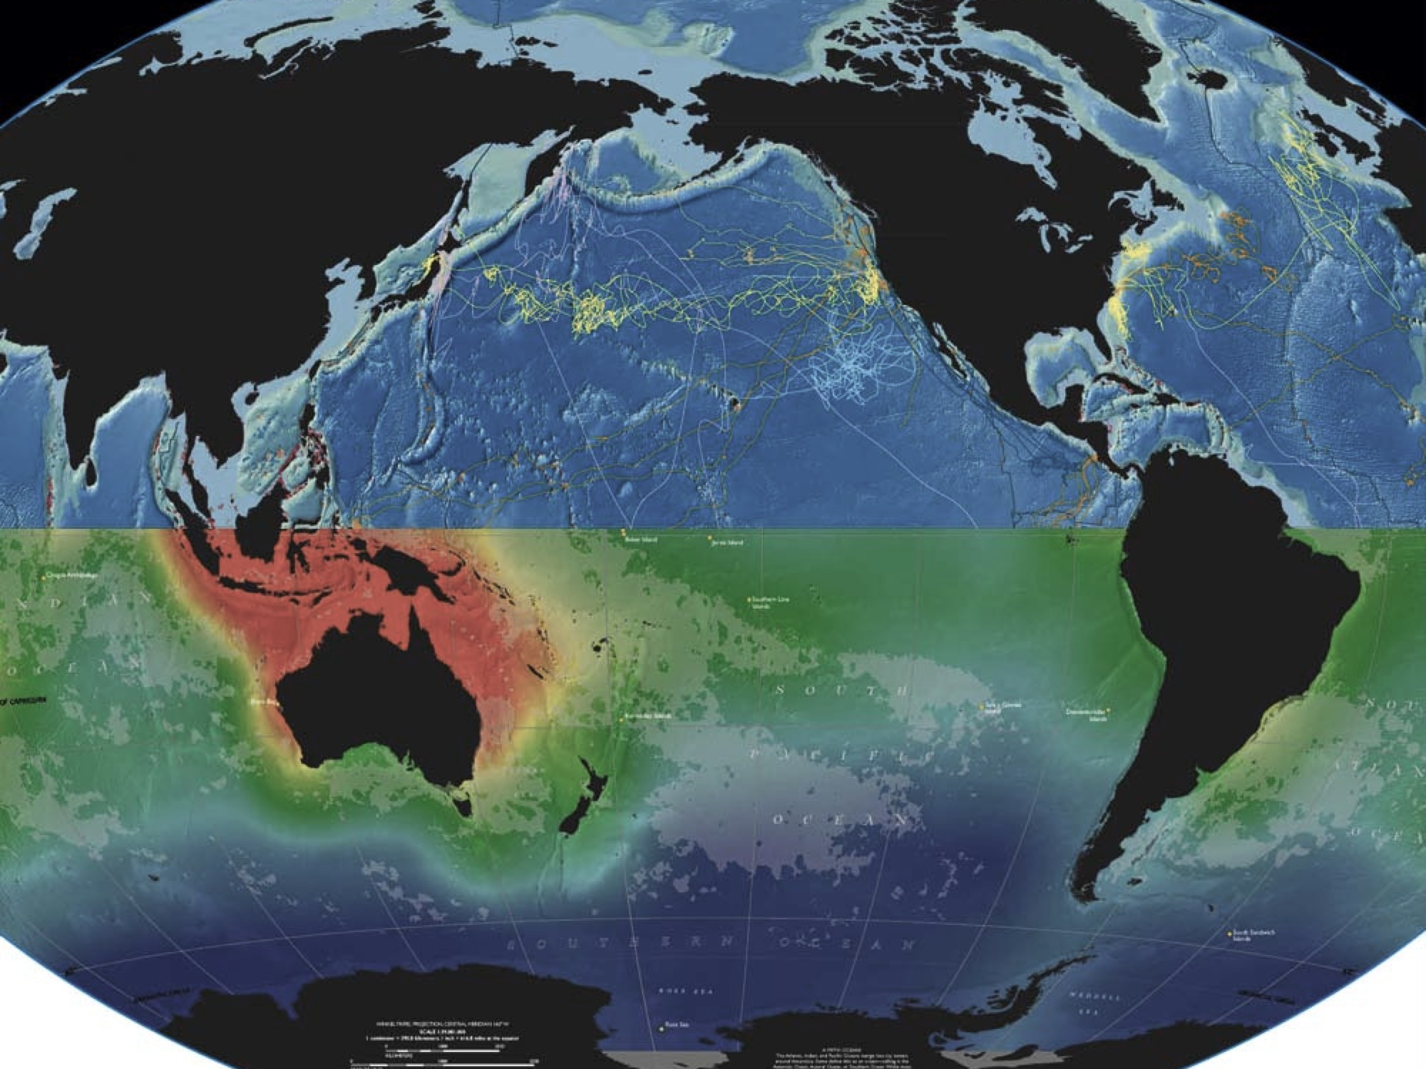


Oceans of Data &
Reproducible Research
bit.ly/2017-01-RepRes
Ben Best, PhD (EcoQuants)
2017-01-25 at UCSB Library’s Collaboratory
Reproducible Data Research: It’s Complicated
coml.org
Notes:
Reproducible Data Research: It’s Complicated | UCSB Library
http://www.library.ucsb.edu/events-exhibitions/reproducible-data-research

Slide 2
Outline
Reproducible Research?
Then
Now
Case Studies
Ocean Health Index
Marine Geospatial Ecology Tools
[Data Science] Resources

Slide 3
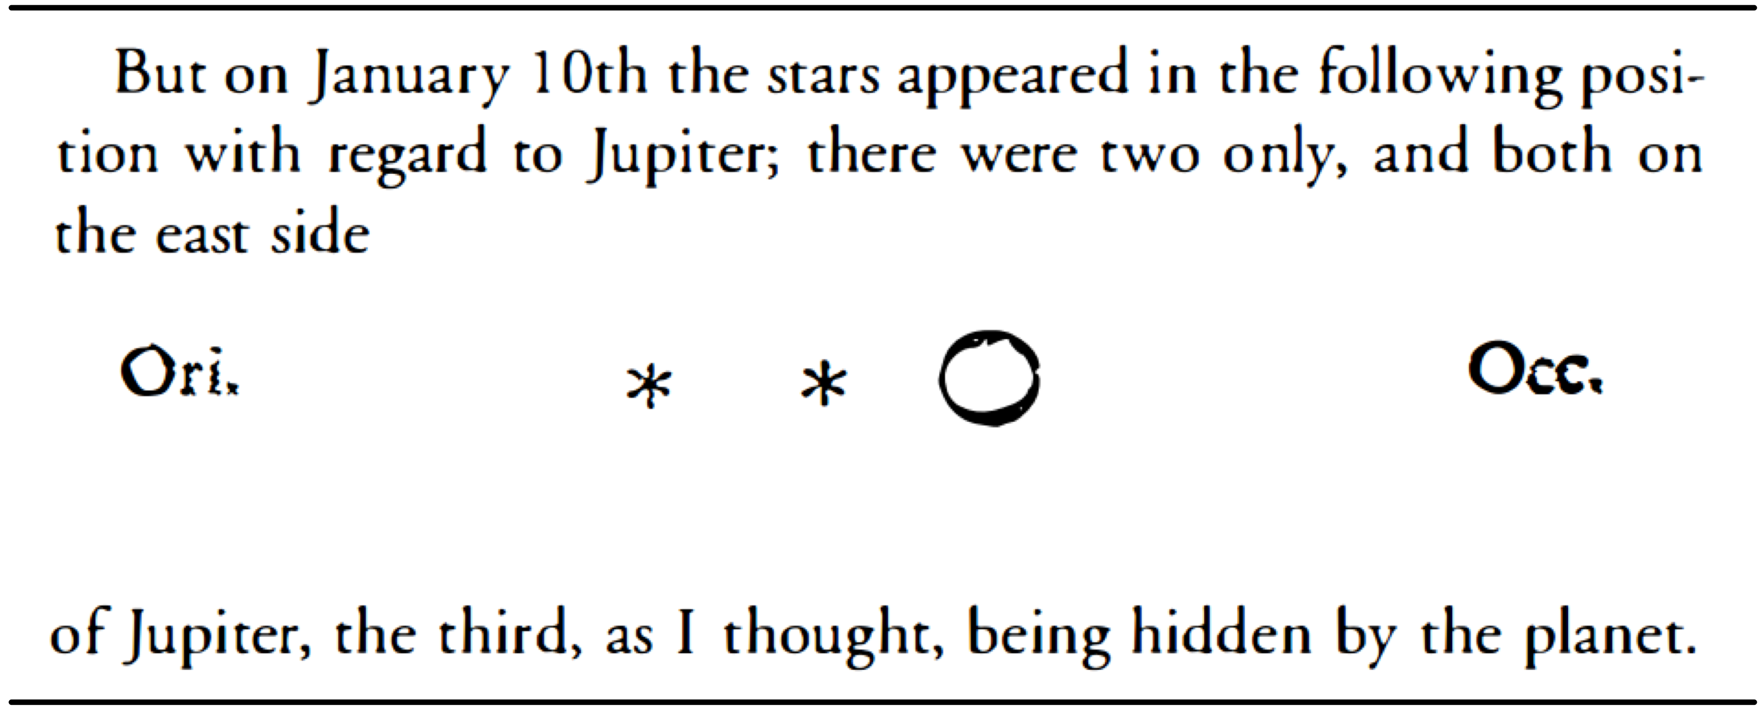
Reproducible Research (RR)
- Galileo Galilei (1610) Sidereus nuncius
Pepe (2014) Science was always meant to be open | Authorea
Notes:
[Science was always meant to be open | Authorea](https://www.authorea.com/users/3/articles/6316/_show_article)
Sidereus nuncius = Starry Messenger
Data: drawings
Metadata: timing (Jan 10)
Text: interpretation
1662 Philosophical Transactions

Slide 4

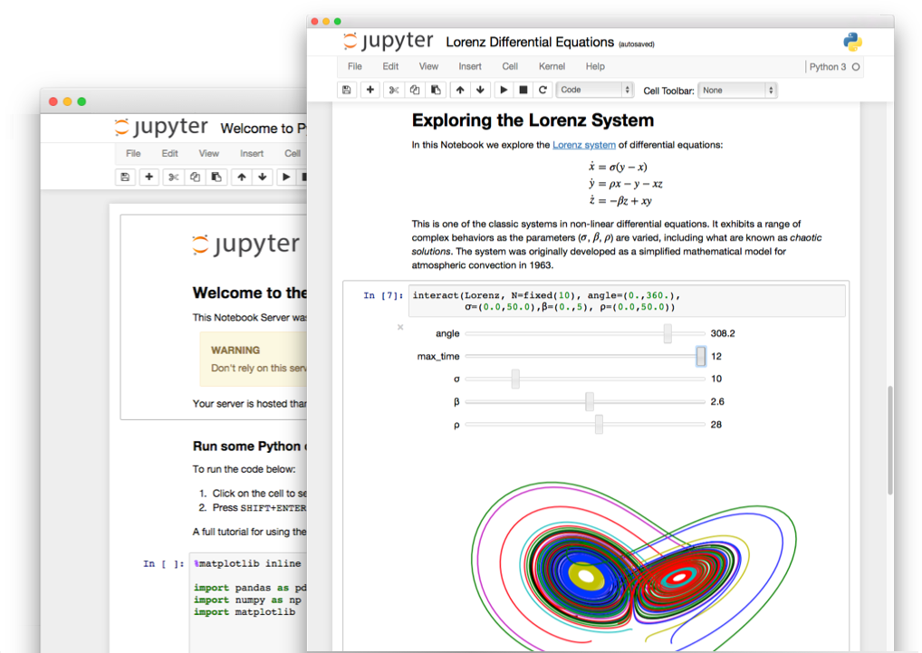
RR with Jupyter Notebooks
jupyter.org

Slide 5
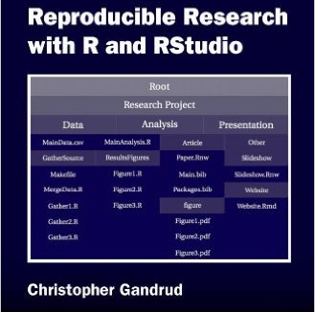
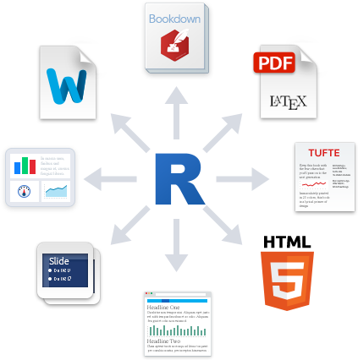
RR with R and RStudio
markdown
christophergandrud.github.io/RepResR-RStudio
rmarkdown.rstudio.com
What is R Markdown? video(1 min) vimeo.com/178485416

Slide 6
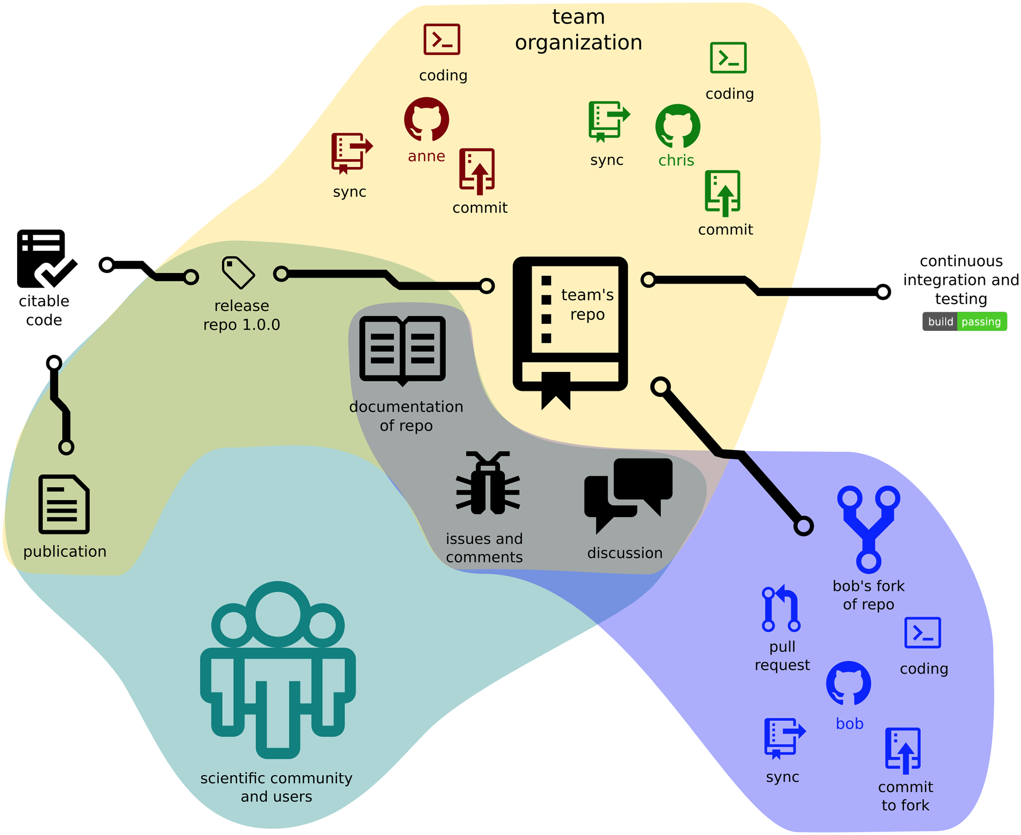
Version (Git) & Share (Github)
Yasset Perez-Riverol (2016) Ten Simple Rules for Taking Advantage of Git and GitHub. PLOS Comp Bio

Slide 7
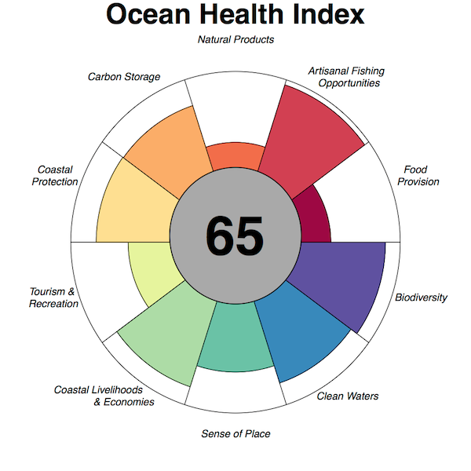
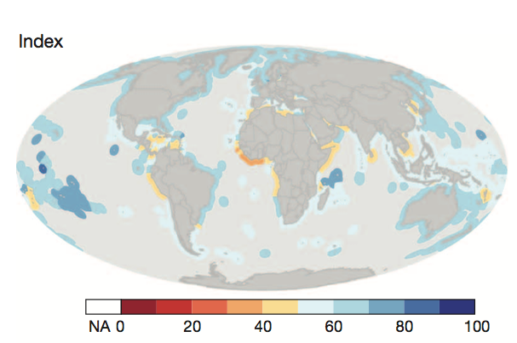
Ocean Health Index (OHI)
"A healthy ocean sustainably delivers a range of benefits to people now and in the future."
Halpern et al (2012) An index to assess the health and benefits of the global ocean. Nature

Slide 8
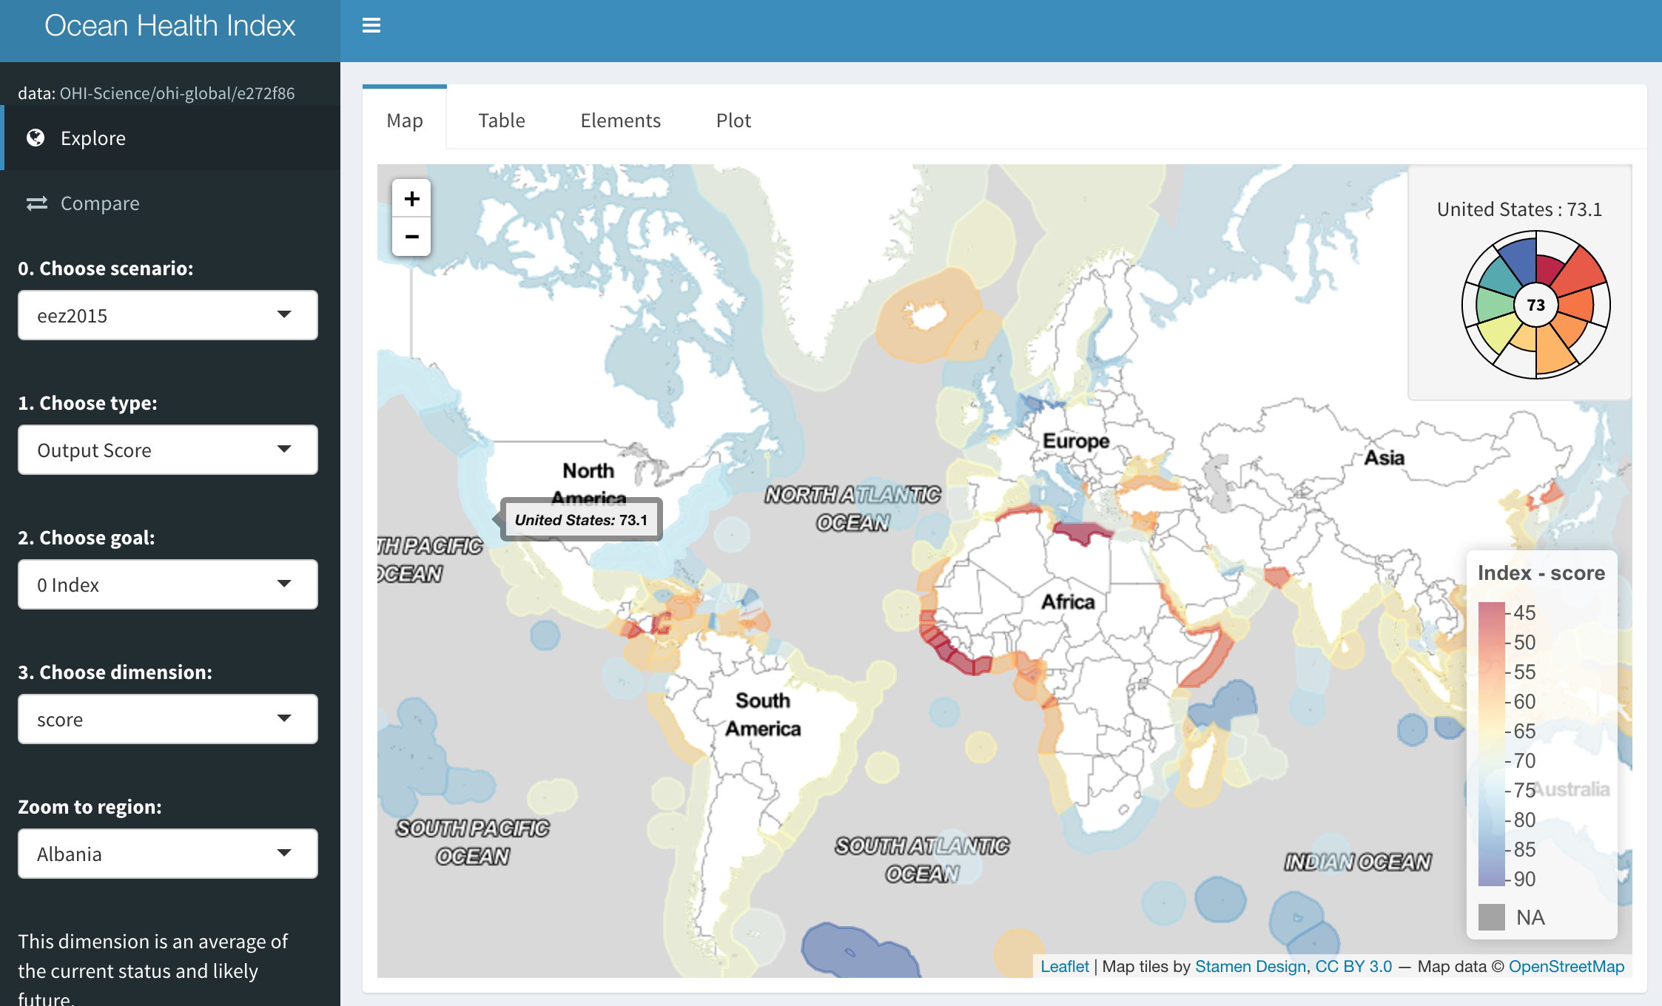
OHI App (R Shiny)
ohi-science.nceas.ucsb.edu/ohi-global

Slide 9
OHI Growth into RR
Lowndes et al (in revision) Better science in less time using open data science tools. Nature Ecology & Evolution
ohi-science.org
Notes:
2012: 130 p supplemental. Excel, manual manipulation of data
2013: modesl in R. from bottleneck of scientists + programmer to scientist-programmers.

Slide 10
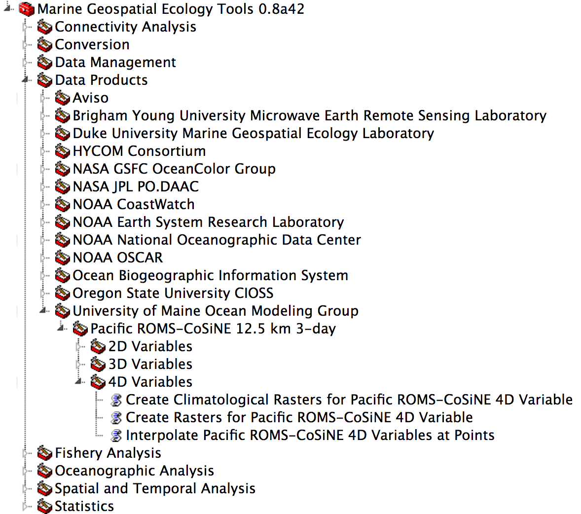
Marine Geospatial Ecology Tools
Roberts et al (2010)Marine Geospatial Ecology Tools: An integrated framework for ecological geoprocessing with ArcGIS, Python, R, MATLAB, and C++. Env Mdl & Sw
mgel.env.duke.edu/mget

Slide 11
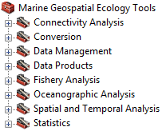
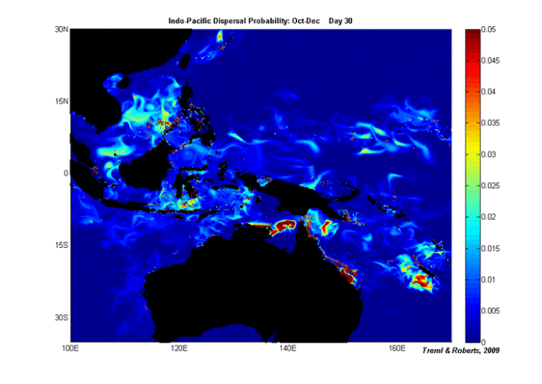
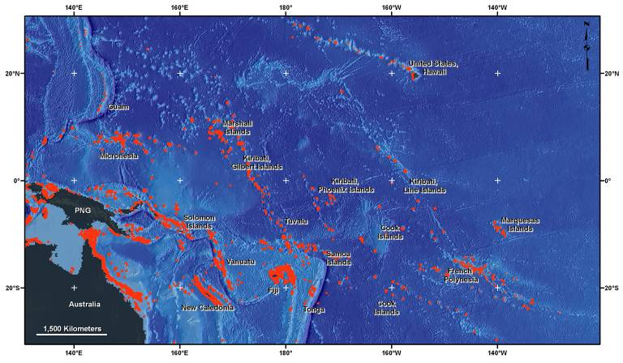
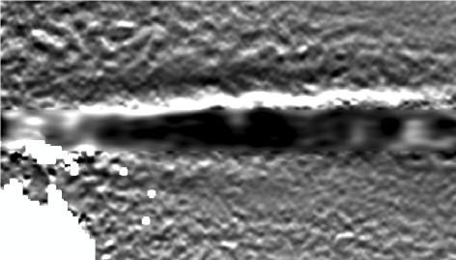
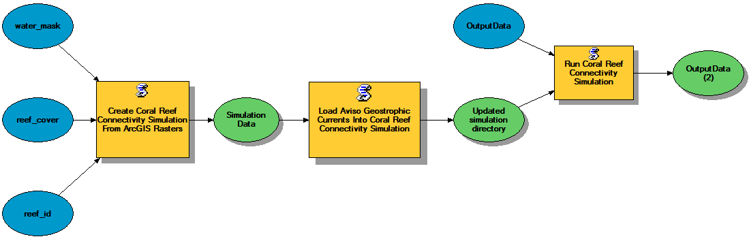
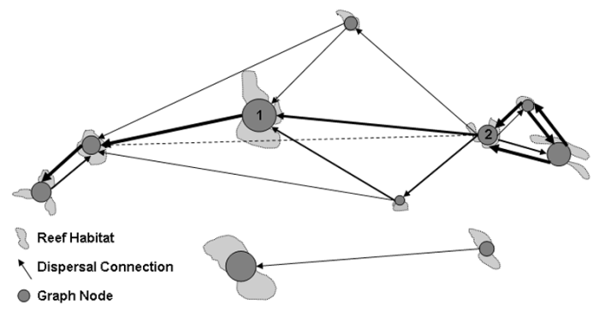
Model larval connectivity
Habitat patches
Ocean currents data
Larval density rasters
Tool downloads data for the region and dates you specify
Edge list feature class representing dispersal network

Slide 12
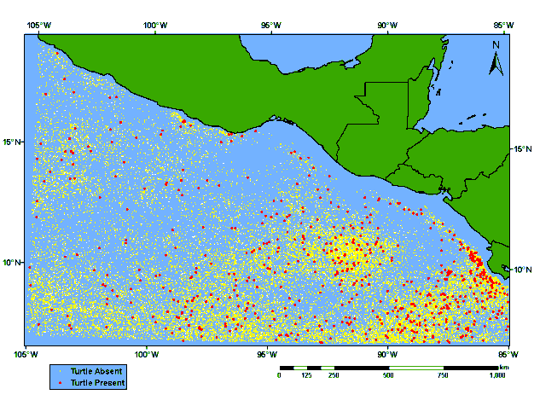
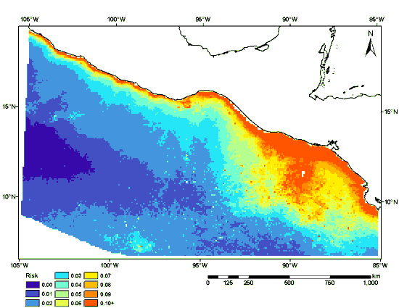
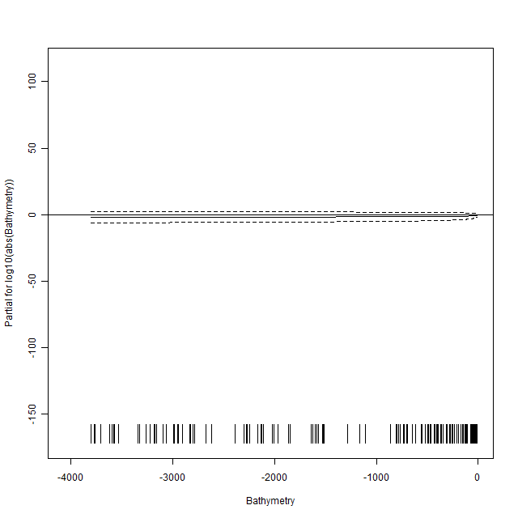
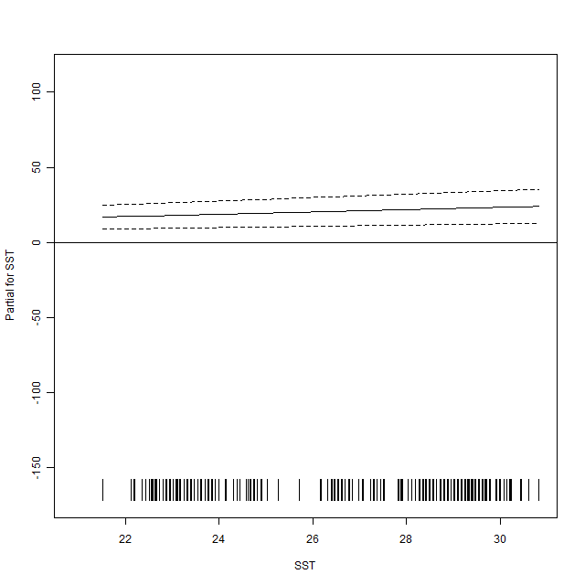
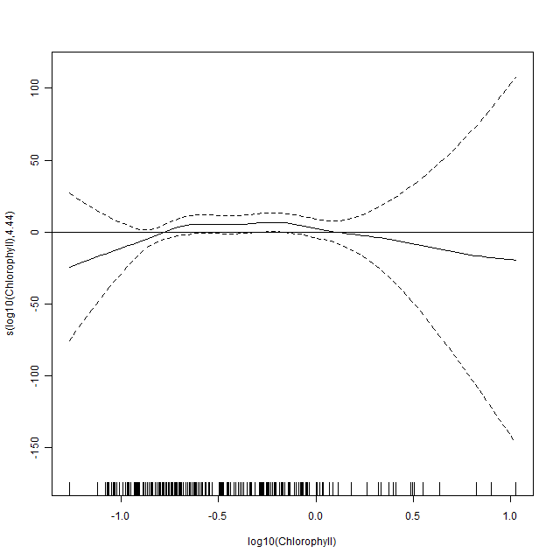
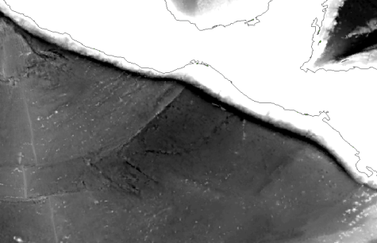
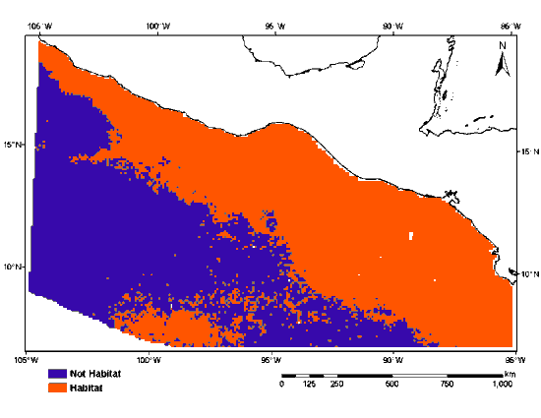
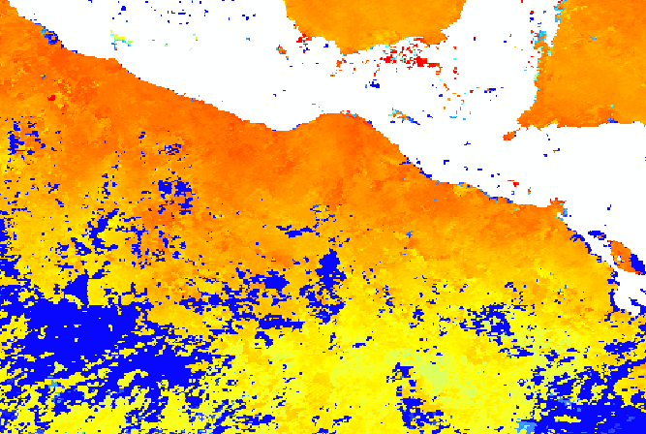
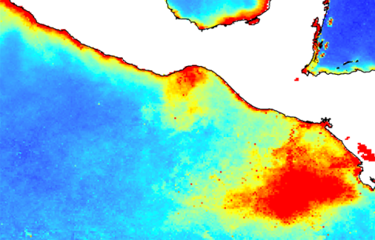
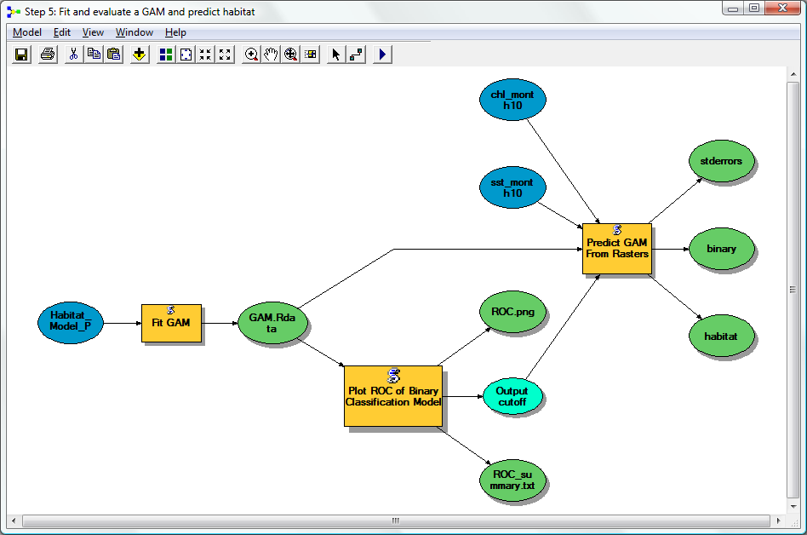
Model species habitat
Point observations of species
Probability of occurrence predicted from environmental covariates
Predictive model
Gridded environmental data
Binary classification
Bathymetry
SST
Chlorophyll

Slide 13


R for Data Science
tidyverse.org
“Data scientists, according to interviews and expert estimates, spend from 50 percent to 80 percent of their time mired in the mundane labor of collecting and preparing data, before it can be explored for useful information.” - NYTimes (2014)
r4ds.had.co.nz

Slide 14
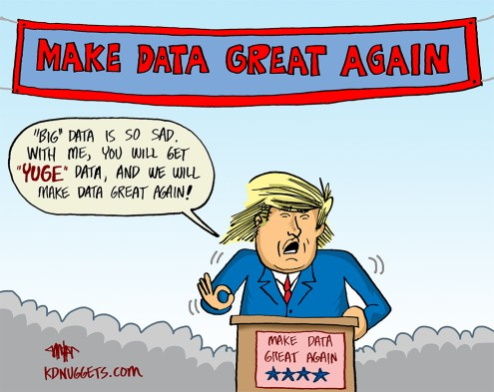

Slide 15



User Groups
There are a lot of user groups in SB area:
Santa Barbara R Users Group: community R
Santa Barbara Data Science: community big data
Data Science at UCSB: undergrad seminars
UCSB Data Science: grad learning
Eco Data Science: Bren/NCEAS grad learning

Slide 16
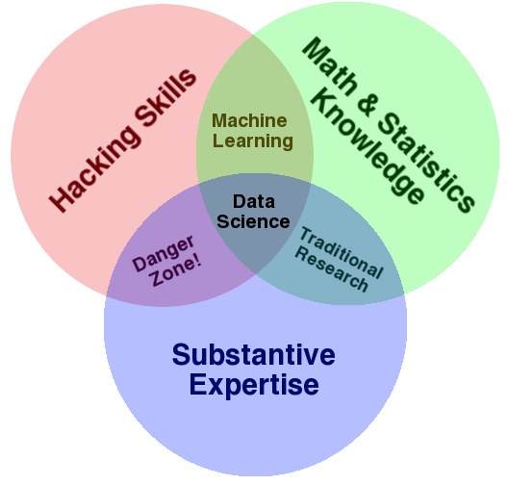
Data Science Testimonials
Data Scientist: The Sexiest Job of the 21st Century (Harvard Business Review, 2012)
Data scientists are the magicians of the Big Data era… 190,000 projected shortage in data scientists by 2018. Universities Offer Courses in a Hot New Field: Data Science (NY Times, 2013)
[Data scientists] responsible for a team of 1-3 earn [a median salary of] $140,000 and those responsible for a team of 10 or more earn $232,500. By contrast, the mean average annual income for a lawyer in America was $131,990 in 2013, while doctors earned $183,940. Tell Your Kids to Be Data Scientists, Not Doctors (Wired, 2014)

Slide 17
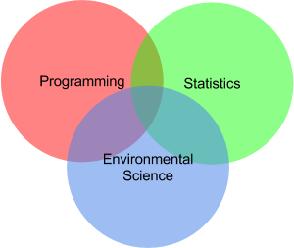
Data Science Resources
BenBestPhD.com : Teaching : Environmental Informatics course, Software Carpentry workshop
OHI-science.org/resources/links
NCEAS.ucsb.edu/ecoinfo
presentation: bit.ly/2017-01-RepRes
email: ben@ecoquants.com
Thank you!

